Slide 1
Applied Materials Interview Presentation
Speaker : Wen-Yuan Chen (陳文遠) / Chris
Position : Algorithm Developer (Intern)
Date : March 25, 2020

Slide 2
INTRODUCTION

Slide 3
ABOUT
EDUCATION
 | National Tsing Hua University (GPA 4.08) Institute of Communications Engineering (MS) | Hsinchu, Taiwan Sep. 2019 – Present
 | Feng Chia University Department of Communications Engineering (BS) | Taichung, Taiwan Sep. 2014 – Jan. 2019
ACADEMIC EXPERIENCE
2018 National University Competition of Python
2017 IMP 2017 Conference
2017 Independent Study Competition
Certified
Publish
Honorable Mention Award

Slide 4
SKILLS
WHAT I HAVE DONE
Skills |  | Tools
Website and Server Develop | Node.js(Server), HTML, Javascript, CSS
Computer Vision | C++(or Python) with OpenCV
Network Programming | C language
Embedded System Development | C(or Python) with Raspberry PI
Communication Simulation | Matlab
Blockchain Technology | Go lang with Hyperledger
Linux (UNIX) Operation | Basic operation

Slide 5
PROJECT

Slide 6
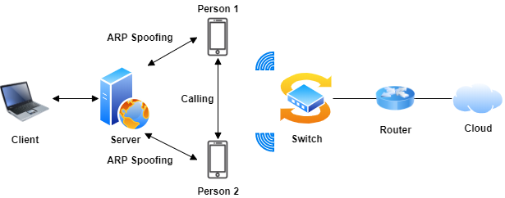
(1) VoIP Phone Call Monitoring Platform
PURPOSE
Provide VoIP phone call monitoring and management service to user.
ARCHITECTURE

Slide 7
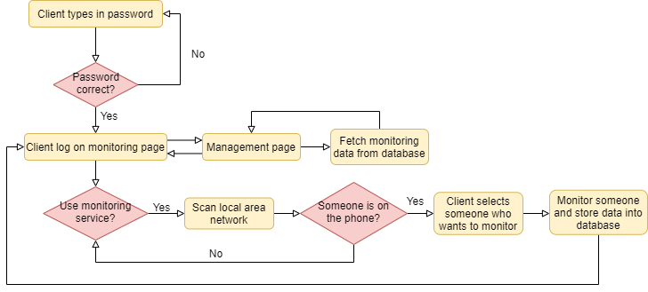
(1) VoIP Phone Call Monitoring Platform (Cont.)
FLOWCHART

Slide 8
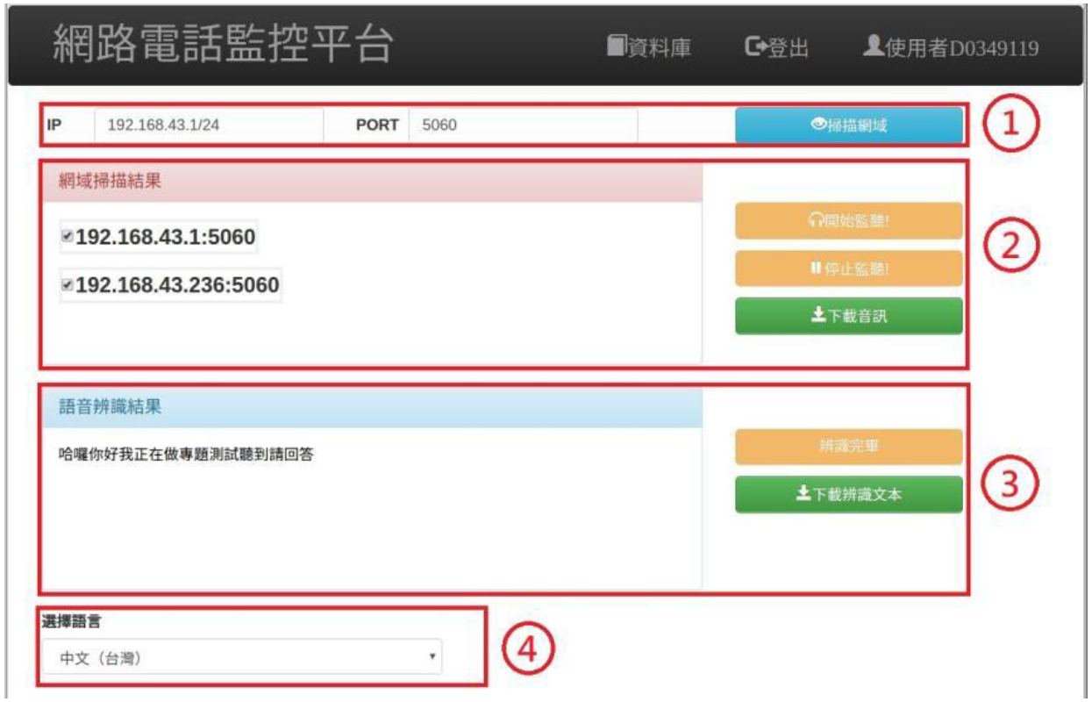
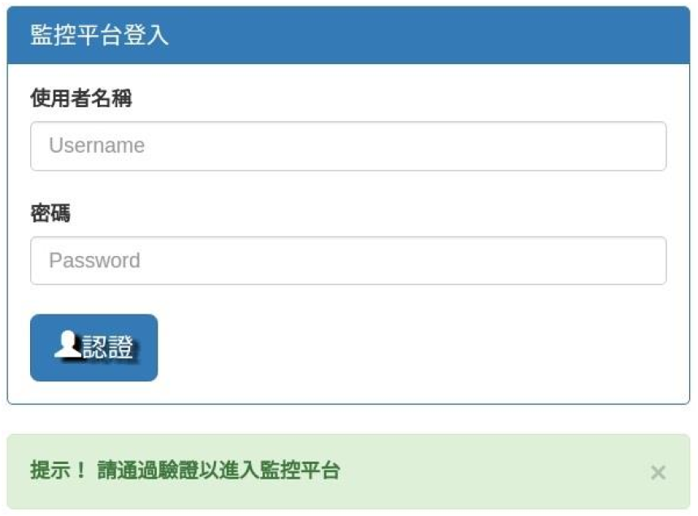
(1) VoIP Phone Call Monitoring Platform (Cont.)
RESULTS
Fig 1. Login page
Fig 2. Monitoring page

Slide 9
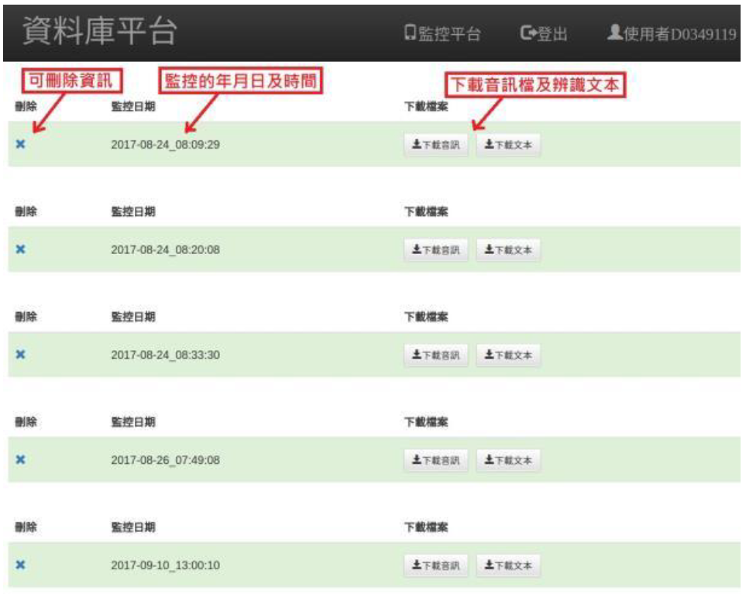
(1) VoIP Phone Call Monitoring Platform (Cont.)
RESULTS
Fig 3. Management page

Slide 10

(2) Blockchain Traceability System with HyperQL
What’s Blockchain?
Blockchain is a kind of decentralized database.
Advantage of blockchain technology :
Blockchain has immutable property that keep data secure.
Disadvantage of blockchain technology :
Query data from the blockchain ledger is complex and slow.
Blockchain Ledger
Query data

Slide 11
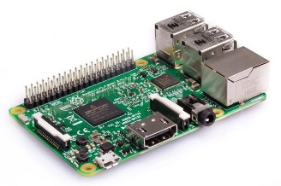
(2) Blockchain Traceability System with HyperQL
(2) Blockchain Traceability System with HyperQL (Cont.)
PURPOSE
Create a blockchain-based IoT system and propose an architecture, named “HyperQL”, to speed up the query speed.
ARCHITECTURE
Blockchain Ledger
Node
Collect data and submit to blockchain
IoT device

Slide 12
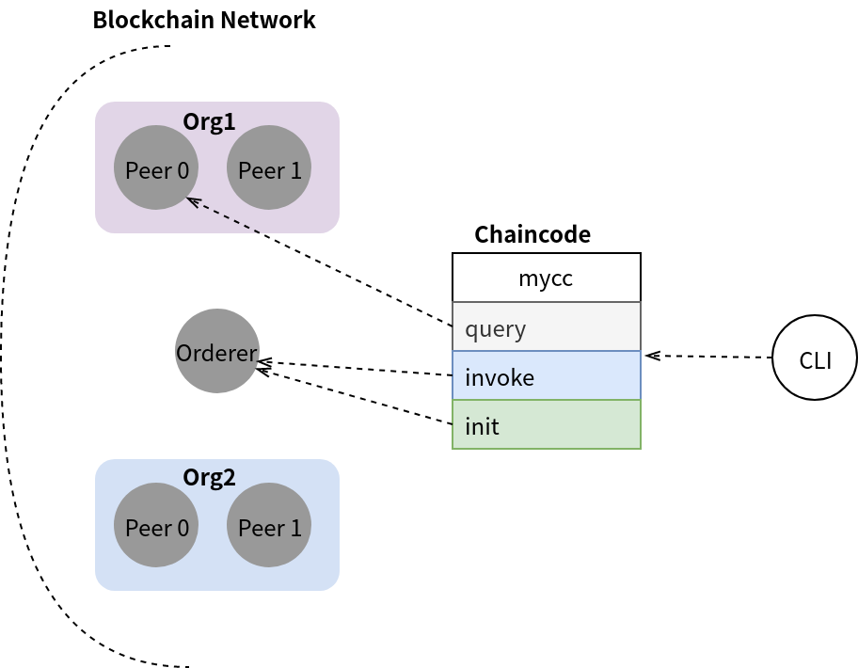
(2) Blockchain Traceability System with HyperQL (Cont.)
METHOD
Blockchain Ledger

Slide 13
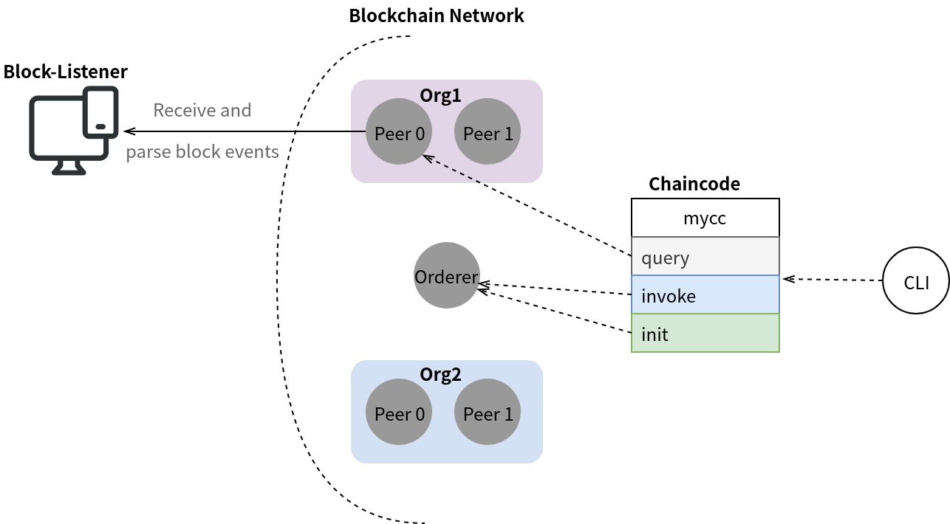
(2) Blockchain Traceability System with HyperQL (Cont.)
METHOD
Blockchain Ledger

Slide 14
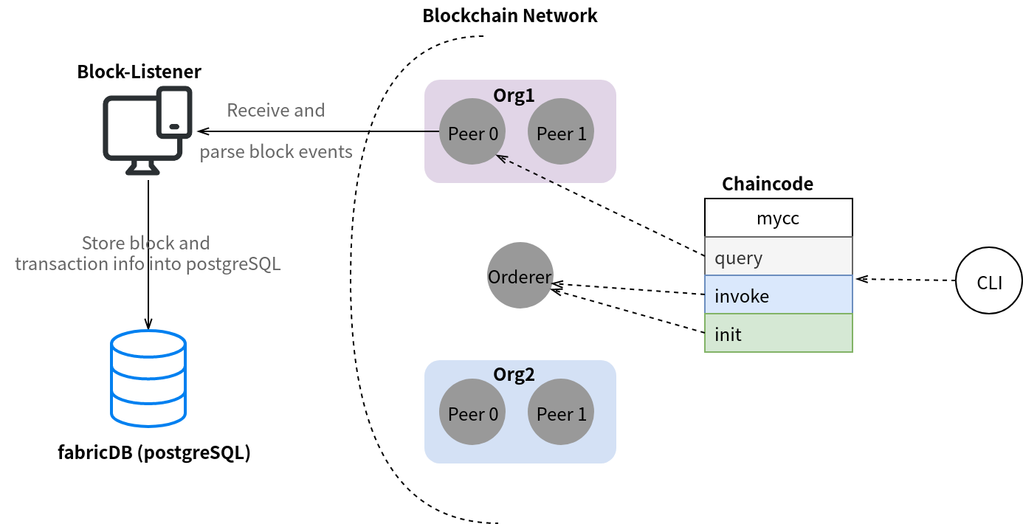
(2) Blockchain Traceability System with HyperQL (Cont.)
METHOD
Query data

Slide 15
(2) Blockchain Traceability System with HyperQL (Cont.)
ISSUES
Advantage :
Query data from the database is nearly 50 times faster than query from blockchain.
Disadvantage :
The data in the database is not immutable.
Future work :
Design an algorithm to efficiently synchronize the data in blockchain and database.
With this, we can keep the data secure while having faster query speed.

Slide 16
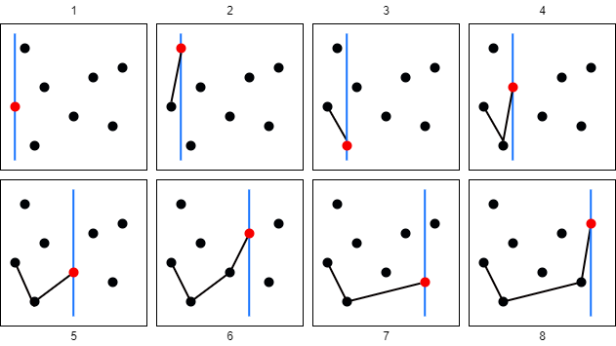
(3) Convex Hull Algorithm
PURPOSE
Learn how to solve convex hull problem.
METHOD
My way of thinking :
Find the bottom-left point first.
Iterate the others from left to right to find the point that can form the smallest slope.
If the same slope occurs, take the longer one.
Do step 1 2 3 until reaching the far right
Then do the same thing from right to left.

Slide 17
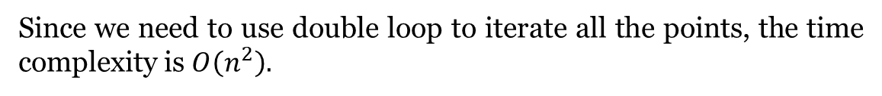
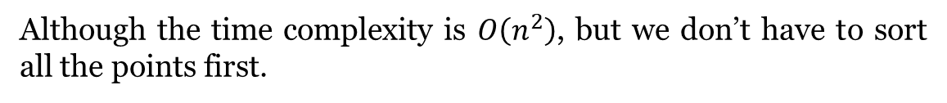
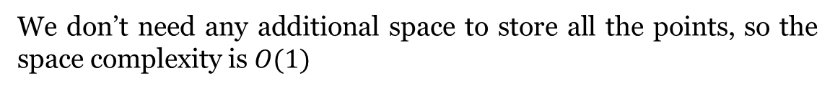
(3) Convex Hull Algorithm (Cont.)
ANALYZE
Time Complexity :
Since we need to use double loop to iterate all the points, the time complexity is $O\left(n^{2}\right).$
Space Complexity :
We don’t need any additional space to store all the points, so the space complexity is $O(1)$
Discuss :
Although the time complexity is $O\left(n^{2}\right)$, but we don’t have to sort all the points first.

Slide 18
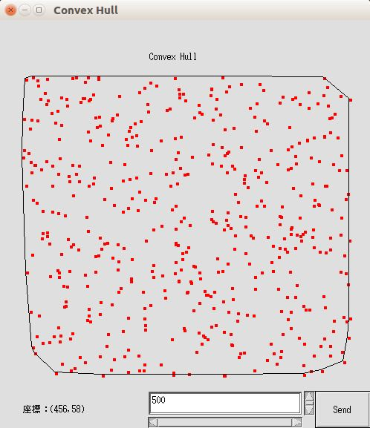
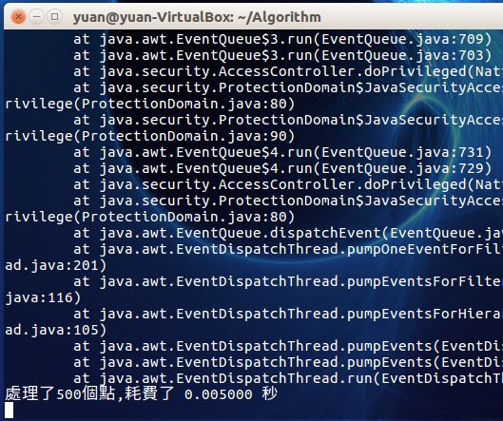
(3) Convex Hull Algorithm (Cont.)
RESULTS

Slide 19
Thank you for your time

